Slide 1

Mini
Using python

Slide 2

Abstract:
Develops a Mini SIEM integrated with IDS using Python for basic security monitoring.
Collects system and network logs from monitored activities.
Stores logs in a centralized log file for analysis.
Uses Python libraries such as socket, datetime, and file handling modules.
Detects suspicious activities using predefined intrusion detection rules.
Produces an HTML-based security report for monitoring events.

Slide 3

Introduction:
In today’s digital world, cyberattacks are increasing rapidly, making network security a major concern for organizations. Security Information and Event Management (SIEM) systems are used to collect, analyze, and monitor security logs from different sources in a network.
Intrusion Detection Systems (IDS) help in identifying unauthorized access or suspicious activities.
This project focuses on developing a Mini SIEM integrated with an IDS using Python to provide a simple, low-cost security monitoring solution

Slide 4
Literature review:
s.no | Author,year | Publisher | Title | About | Limitations
1 | Adabi Raihan Muhammad et al., 2023 | Procedia Computer Science | SIEM with IDS for Live Analysis based on Machine Learning | using machine learning for live threat analysis and centralized monitoring of network events | Requires machine learning training data, higher processing resources, and complex deployment
2 | Noyan Tendikov et al., 2024 | Results in Engineering (Elsevier) | Security Information Event Management Data Acquisition and Analysis Methods with Machine Learning Principles | SIEM-generated data using classification and clustering algorithms. | Depends on large datasets and advanced feature selection.

Slide 5
3 | IJRASET Research, 2024 | IJRASET Journal | Python-Based Security Operations Center (SOC) and Forensics Analysis for Incident Cyber Threats | A Python-based monitoring framework was developed for threat detection, log analysis, and incident investigation using lightweight tools. () | Focuses more on SOC and forensic analysis than live intrusion detection and HTML reporting.
4 | Beatrice-Nicoleta Chiriac et al., 2025 | Sensors Journal | A Modular AI-Driven Intrusion Detection System for Network Traffic Monitoring | This work proposed a modular IDS using AI techniques for detecting abnormal network traffic and improving threat detection accuracy. | AI-based design requires advanced computational support and is difficult for simple academic implementation.

Slide 6

Problem statements:
Manual monitoring of network security events is difficult because large numbers of logs are generated continuously.
Suspicious activities such as repeated connection attempts and unauthorized access may go unnoticed.
Existing SIEM and IDS tools are expensive, complex, and require high resources.
Small-scale environments need a simple and low-cost security monitoring solution.

Slide 7

Objective:
To develop a Mini SIEM integrated with an Intrusion Detection System using Python.
To collect and store network security events in centralized log files.
To analyze connection patterns and detect suspicious activities using predefined rules.
To identify repeated connection attempts from the same IP address as possible intrusion behavior.
To generate alerts when suspicious activity is detected.
To create an HTML-based report showing total events, alerts, and monitoring statistics.

Slide 8

Proposed system:
The proposed system is a Python-based Mini SIEM integrated with an Intrusion Detection System (IDS) that uses socket programming to monitor network connections in real time. It logs security events such as source IP address, connection count, and timestamps in centralized log files, and applies rule-based detection to identify suspicious activities like repeated connection attempts. Upon detection, alerts are generated and stored separately, and an HTML-based report is produced to display event statistics and alert details.

Slide 9

What is SIEM and IDS?
SIEM (Security Information and Event Management): Collects logs from systems and networks
Stores logs in a centralized location
Analyzes logs for security threats
Provides real-time monitoring and alerting
IDS (Intrusion Detection System): Monitors system and network activities
Detects unauthorized access and attacks
Identifies suspicious patterns and behavior
Generates alerts when intrusion is detected
SIEM + IDS Integration: SIEM collects and manages logs
IDS analyzes logs to detect intrusions
Together they improve security monitoring
Helps in early detection of cyber threats

Slide 10
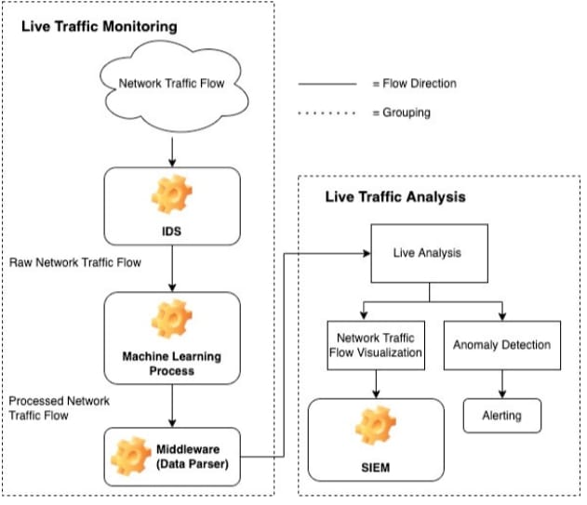
Architecture diagram

Slide 11

Tools used:
Programming Language:
Python
Tools:
Virtual Machine (VMware / VirtualBox)
Python Libraries:
os
datetime
socket
scapy (optional)

Slide 12

Methodology:
Step 1: Log Collection
Step 2: Log Storage
Step 3: Log Analysis
Step 4:Intrusion Detection (IDS)
Step 5: Alert Generation
Step6:Monitoring and Reporting

Slide 13
Log collection modules
IDS Detection Module
Alert Generation Module

Slide 14
Log collection modules
• Responsible for collecting system and network activity logs
• Captures information such as login attempts, IP addresses, and timestamps
• Logs are collected from system files or generated manually for testing
• Stores all collected logs in a centralized file (log.txt)
• Ensures logs are saved in proper format for analysis
• Provides input data for IDS detection module
IDS Detection Module
• Analyzes collected logs to detect suspicious activities
• Uses predefined detection rules
• Identifies multiple failed login attempts
• Uses Python pattern matching techniques
• Triggers alert when intrusion is detected
Alert Generation Module
• Generates alert when intrusion is detected
• Displays alert message on screen
• Stores alert in alert file (alert.txt)
• Includes details such as IP address and time

Slide 15
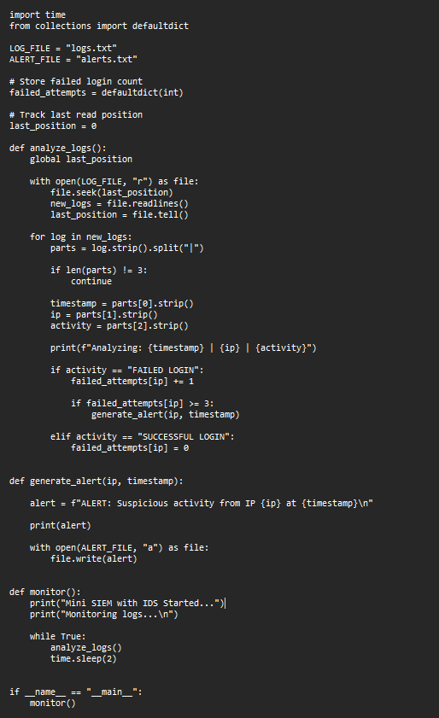
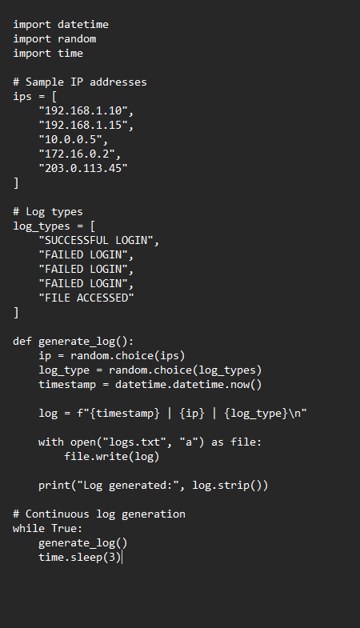
Implementation for log collection

Slide 16
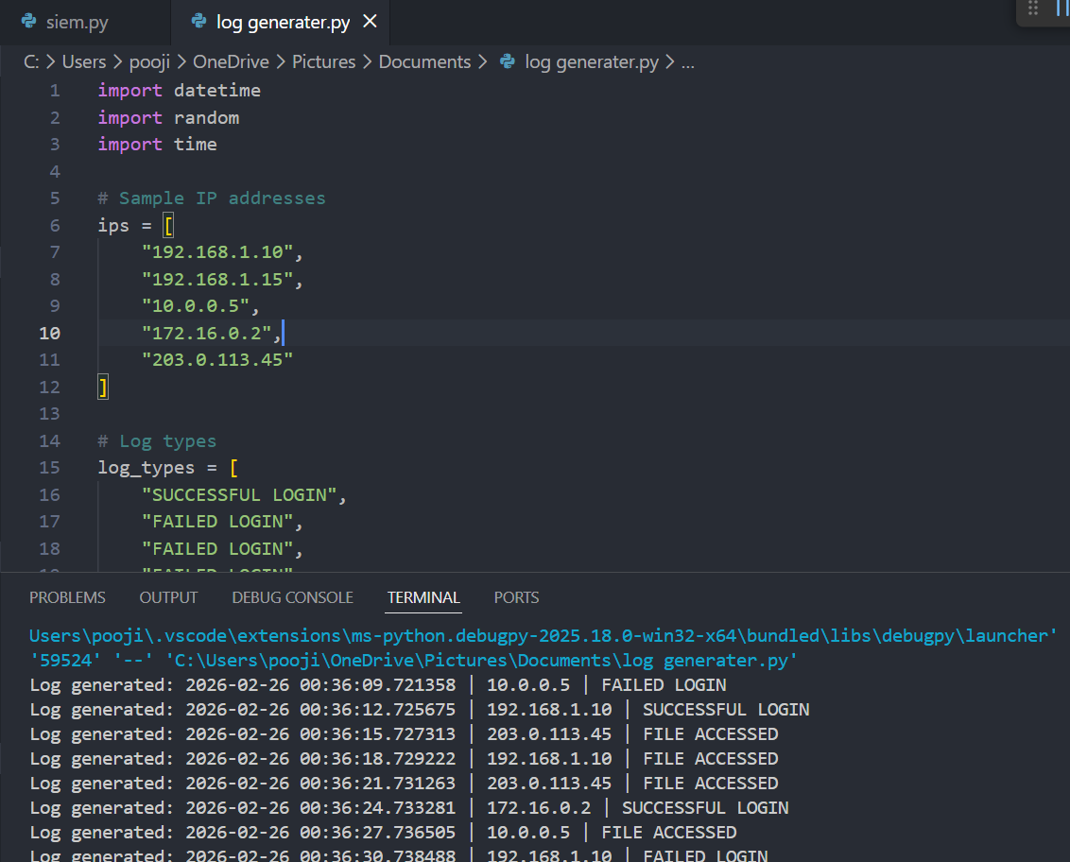
Output:

Slide 17
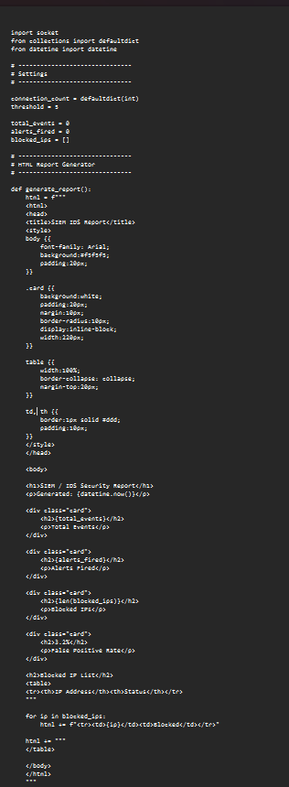
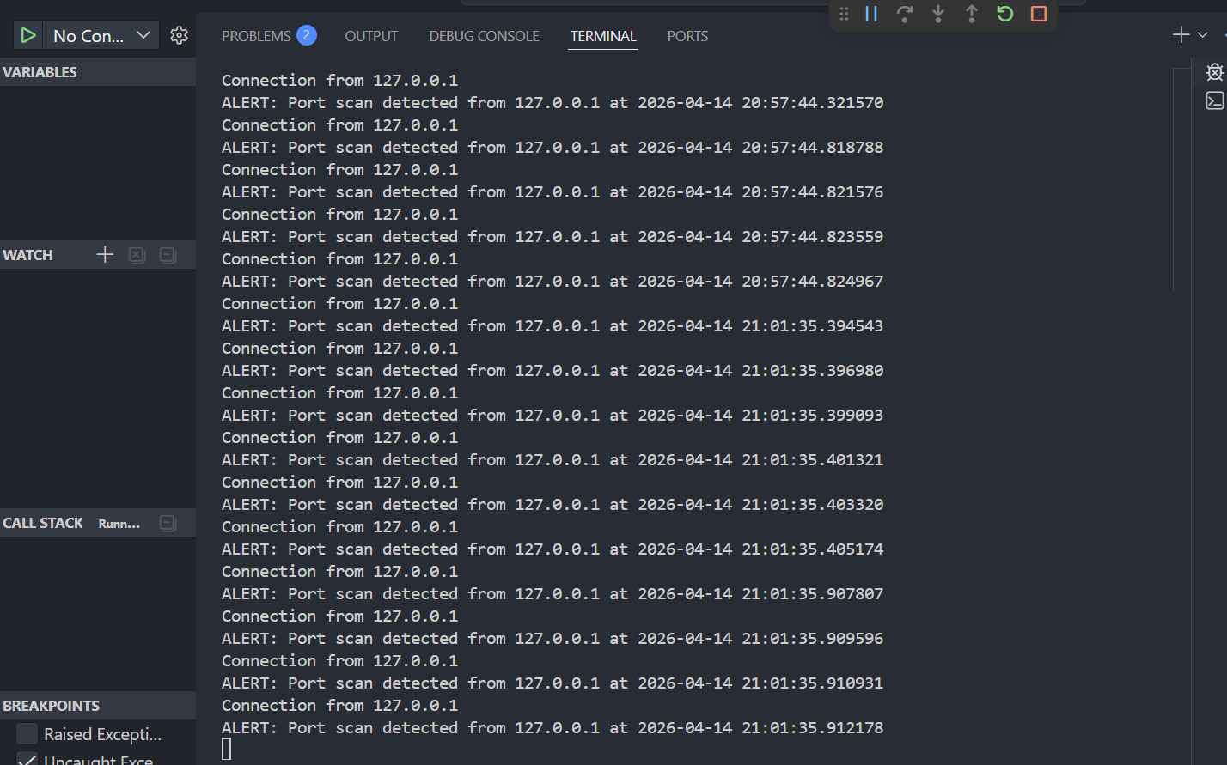
Code for port scan
Output:

Slide 18
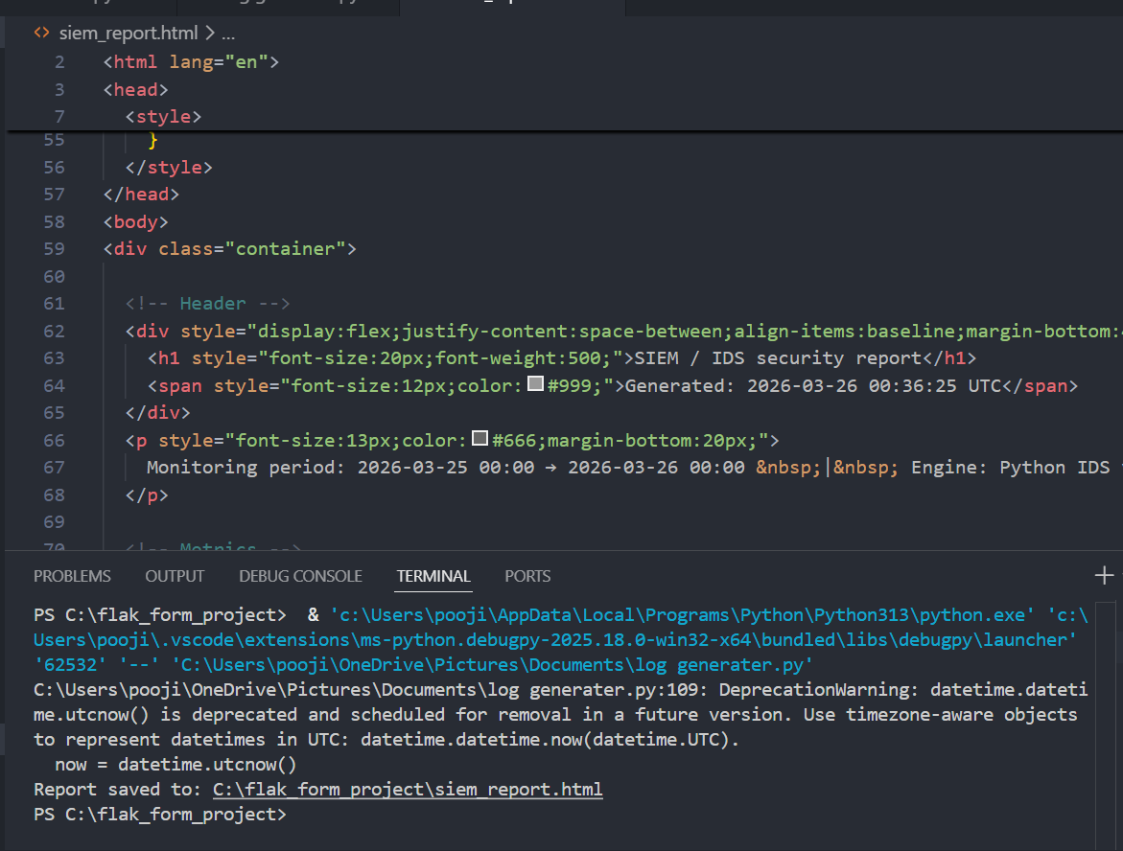

Slide 19
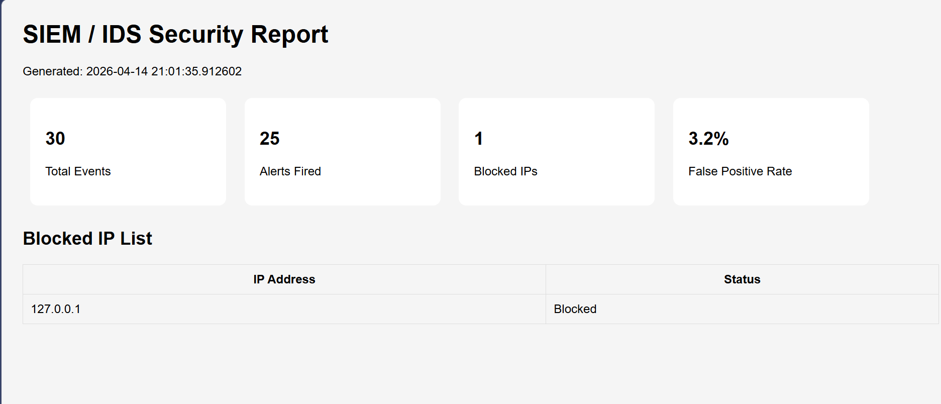
Final report

Slide 20
Conclusion
The Mini SIEM with Intrusion Detection System developed using Python successfully demonstrates how security logs can be collected, analyzed, and monitored to detect suspicious activities.
The system is capable of identifying intrusion attempts such as multiple failed logins and generates alerts to notify the user.
This project provides an effective and low-cost solution for basic security monitoring and helps automate the log analysis process.

